Slide 1
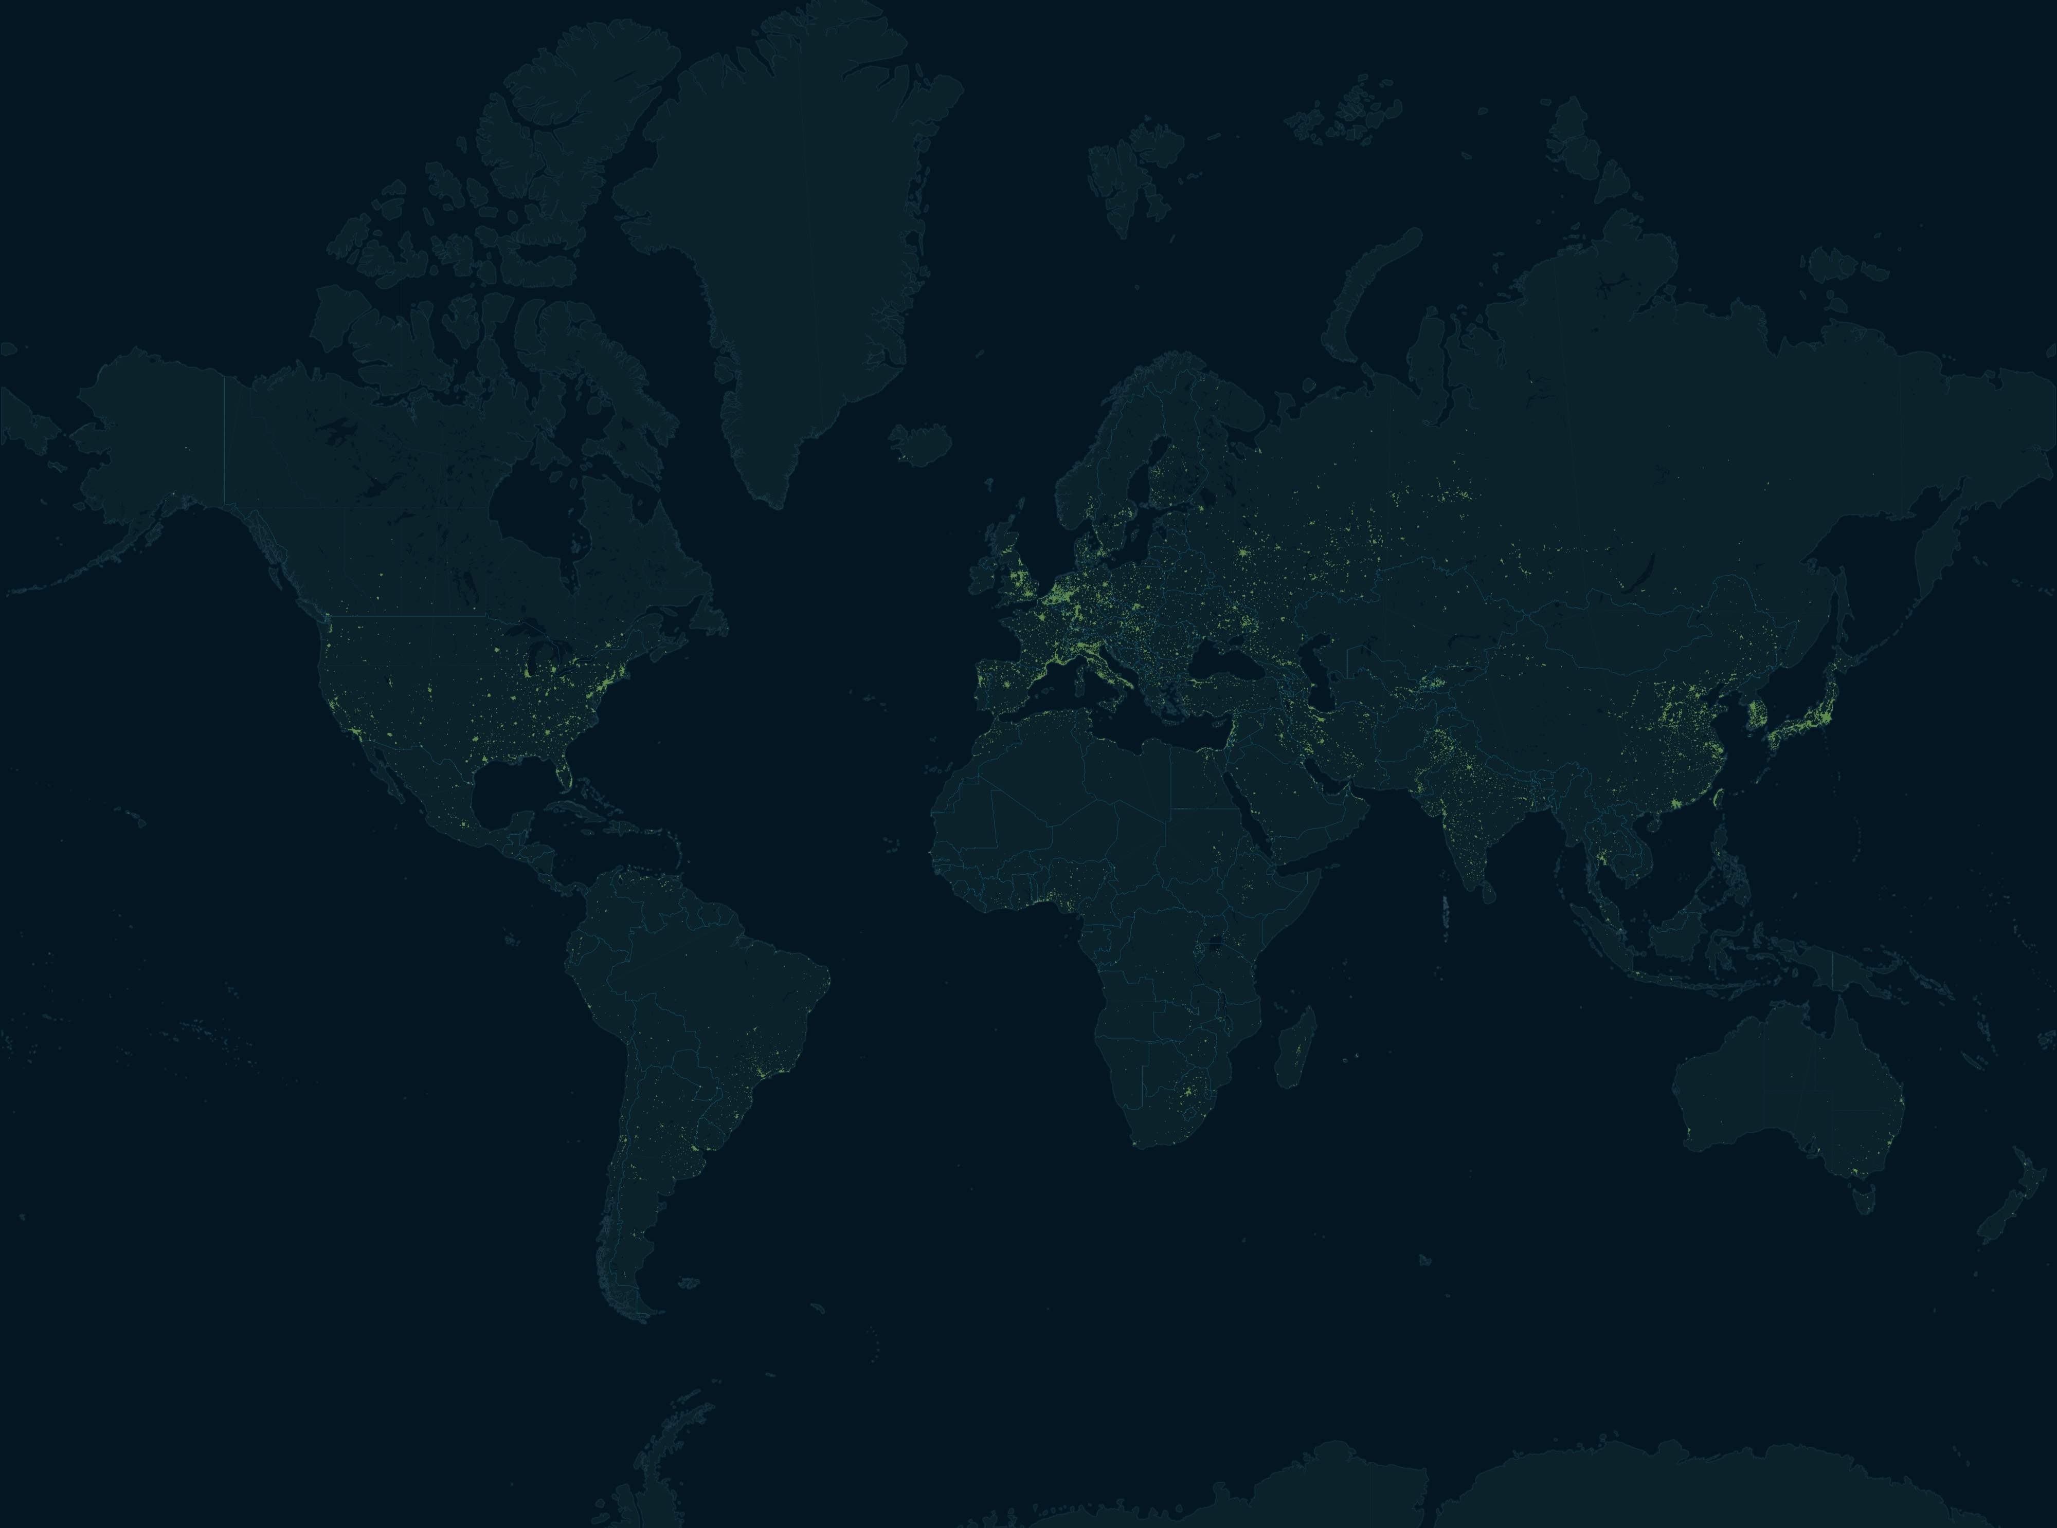
Flying Under the Radar
Wildlife Trafficking in the
Air Transport Sector
The ROUTES Partnership
Notes:
Summary:
Who C4ADS is
Description of ROUTES
Geographic spread of illegal wildlife trafficking
Illegal wildlife trafficking routes and methods used by traffickers
Case studies/examples
Legislation
Recommendations

Slide 2
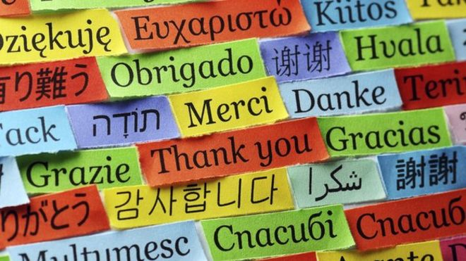
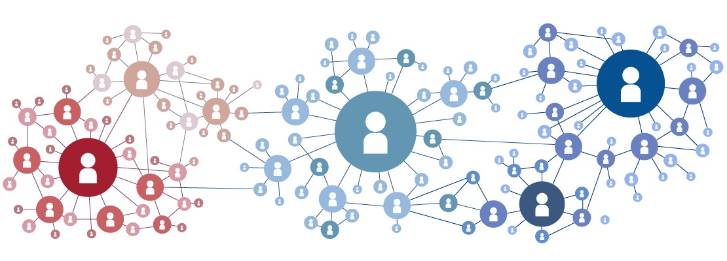
C4ADS Underlying Data & Capabilities
C4ADS is a 501(c)(3) non-profit that leverages data and cutting-edge technologies to uncover and map transnational illicit networks, and leads Data & Analytics for the ROUTES Partnership.
people
Data
technology
Multilingual, well-traveled, and tech-savvy analysts
15+ languages in-house, including Arabic, French, Mandarin, Russian, Spanish, Hindi, Swahili, etc.
Field research in 50+ countries, including conflict zones, e.g. Somalia, Ukraine, Mali, Guatemala, and South Sudan
Integrated suite of “high-advantage” data for commercial investigations
300+ business, tax, property, shipping, and judicial registries in 120 jurisdictions, along with commercial trade, banking, and customs data
Augmented by new data, like social media, satellite imagery, and geo-location
Cutting-edge, emerging technology in innovative & practical ways
Partnerships with leading tech providers like Palantir, Windward, & Panjiva
When we recognize a gap in currently available technology, we regularly adapt or build our own open source software to fill it
Unless specifically stated, the mention of any company, organization, individual, or other entity in this document or any attachments thereto does not imply the violation of any law, statue, or international agreement, and should not be construed as such. SBU Business Proprietary - Not for External Release
Notes:
C4ADS is a small non-profit based in DC and focused on transnational organized crime. We specialize in collecting information in the open source, analyzing it, and packaging it for use by law enforcement or our public and private sector partners. We rely on talented multi-lingual analysts with experience abroad, have access to a wide variety of data sources, and partner with certain tech providers to enhance our analysis. Although our usual goal is LE action, we also can analyze trends and modus operandi associated with different types of transnational crime, which we have been doing for the USAID-ROUTES Partnership.

Slide 3
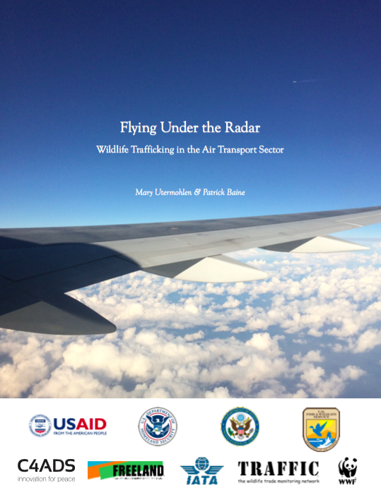
The USAID ROUTES Partnership
The USAID Reducing Opportunities for Unlawful Transport of Endangered Species (ROUTES) Partnership brings together transport and logistics companies, government agencies, development groups, and conservation organizations to disrupt wildlife trafficking through legal transportation supply chains.
We compiled ivory, rhino horn, reptile, and bird seizure data from the air transport sector to:
Identify trafficking hotspots
Identify trafficking trends
Identify the modus operandi of wildlife traffickers
Findings:
Wildlife trafficking through airports is truly global in nature
Large international hub airports are the most likely to be exploited
Hub airports in higher risk regions with many flight options but limited enforcement capacity are most likely to be exploited for wildlife trafficking, along with narcotics and other contraband
Unless specifically stated, the mention of any company, organization, individual, or other entity in this document or any attachments thereto does not imply the violation of any law, statue, or international agreement, and should not be construed as such. SBU Business Proprietary - Not for External Release
Notes:
The USAID ROUTES Partnership is dedicated to reducing wildlife trafficking through legal transportation supply chains. In the first couple years of the project, we are focused on the air transport sector specifically. Under the Partnership, C4ADS is leading Objective 1, which provides the data and analytics that help to guide the efforts of the rest of the ROUTES Partners. In Y1, we began compiling seizure data for ivory, rhino horn, reptiles, and birds to identify trafficking hotspots, trends, and the modus operandi used by wildlife traffickers to identify remaining gaps in the air sector. We analyzed the compiled data and found that wildlife trafficking is truly global in nature, and that large international hub airports are the most likely to be exploited by traffickers. We also found that geographic location was a large factor in an airport’s vulnerability to wildlife trafficking.

Slide 4
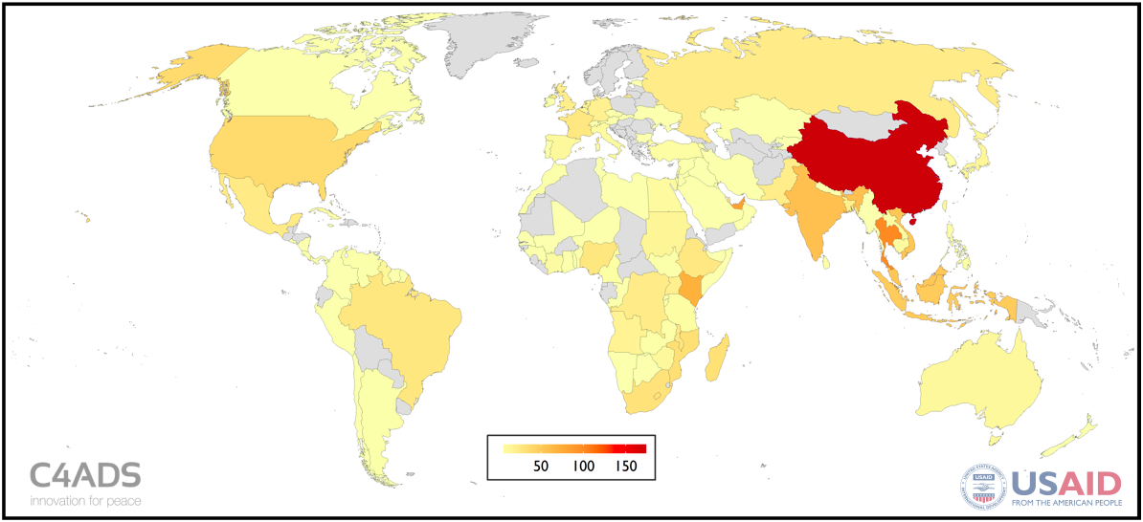
Global Wildlife Trafficking by Air
We found wildlife trafficking to be a truly global problem, affecting the Americas, Europe, and the Middle East in addition to Africa and Asia.
Heat map for all wildlife seizures in the C4ADS Air Seizure Database (Jan 2009 – Aug 2016)
Unless specifically stated, the mention of any company, organization, individual, or other entity in this document or any attachments thereto does not imply the violation of any law, statue, or international agreement, and should not be construed as such. SBU Business Proprietary - Not for External Release
Notes:
Heat map representing all trafficking instances (successful or planned wildlife trafficking attempts) within our database between January 2009 and August 2016. Many believe wildlife trafficking to be an Africa-Asia issue, but our data shows how truly global wildlife trafficking has become. China is clearly prominent here, for the most part due its role in the ivory and rhino horn trades. We also see more unusual regions, like the Middle East, Europe, Americas, and even Australia coming up here, in part because of the importance of transit regions (Europe, Middle East), and in part because of the live animal trade (Europe, Middle East, Americas, Australia).

Slide 5
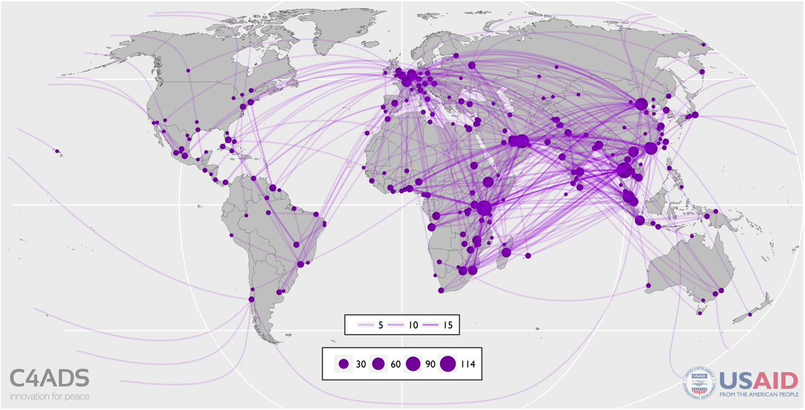
Total Flight Routes
Wildlife trafficking by air moves through large international hub airports, particularly airports with frequent flights from source countries in the Southern Hemisphere (Africa, Latin America) to destination countries in the Northern Hemisphere (Asia, Europe, the Middle East, North America).
Flight Routes for All Wildlife Seizures in the C4ADS Air Seizure Database
(Jan 2009 – Aug 2016)
Unless specifically stated, the mention of any company, organization, individual, or other entity in this document or any attachments thereto does not imply the violation of any law, statue, or international agreement, and should not be construed as such. SBU Business Proprietary - Not for External Release
Notes:
All the flight routes recorded in our database. Again we can see the global nature of wildlife trafficking by air, as well as reliance on prominent transit hubs. For example, we can clearly see Nairobi, Dubai, Charles de Gaulle, and SE Asian airports like Bangkok, which are all transit hubs for their respective regions. The prominence of these airports suggests that focusing more on these points could have a large impact on the operations of wildlife traffickers.

Slide 6
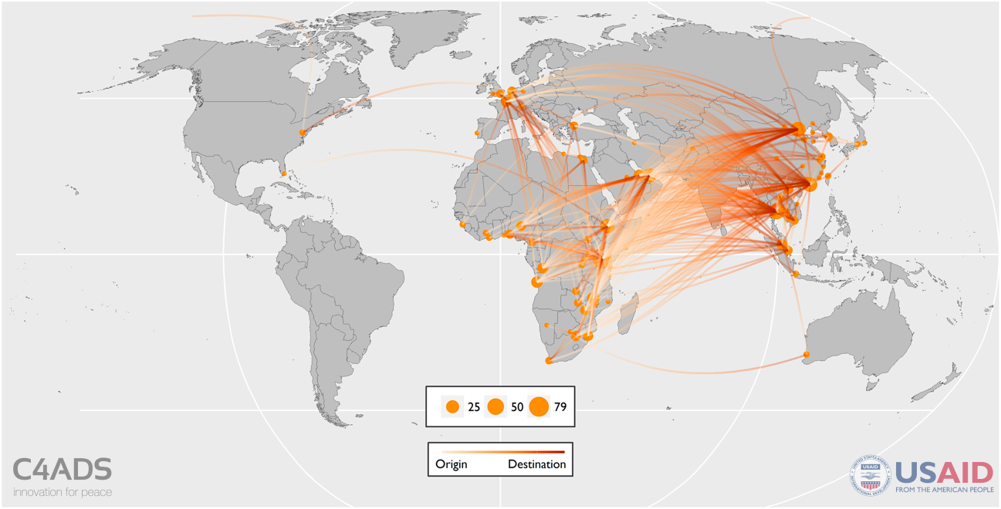
Ivory Flight Routes
Ivory and rhino horn primarily moved between Africa and Asia, but often transited through hub airports in the Middle East and Europe as well.
Top 5 Countries by Trafficking Instance Count:
China
Kenya
Thailand
Malawi
Vietnam
Ivory Trafficking Routes Map (Jan 2009 – Aug 2016)
Unless specifically stated, the mention of any company, organization, individual, or other entity in this document or any attachments thereto does not imply the violation of any law, statue, or international agreement, and should not be construed as such. SBU Business Proprietary - Not for External Release
Notes:
For ivory, we see a clear Africa -> Asia flow. East Africa is clearly significant as both an origin and transit region, and we see flights concentrating in East African hubs on their way to Asia. We also see the Middle East and Europe used as transit regions for ivory moving from Africa to Asia – Europe seems to be increasingly used by traffickers trying to arrive in Asia from less conspicuous airports. We see these tactics used by rhino horn traffickers as well.

Slide 7
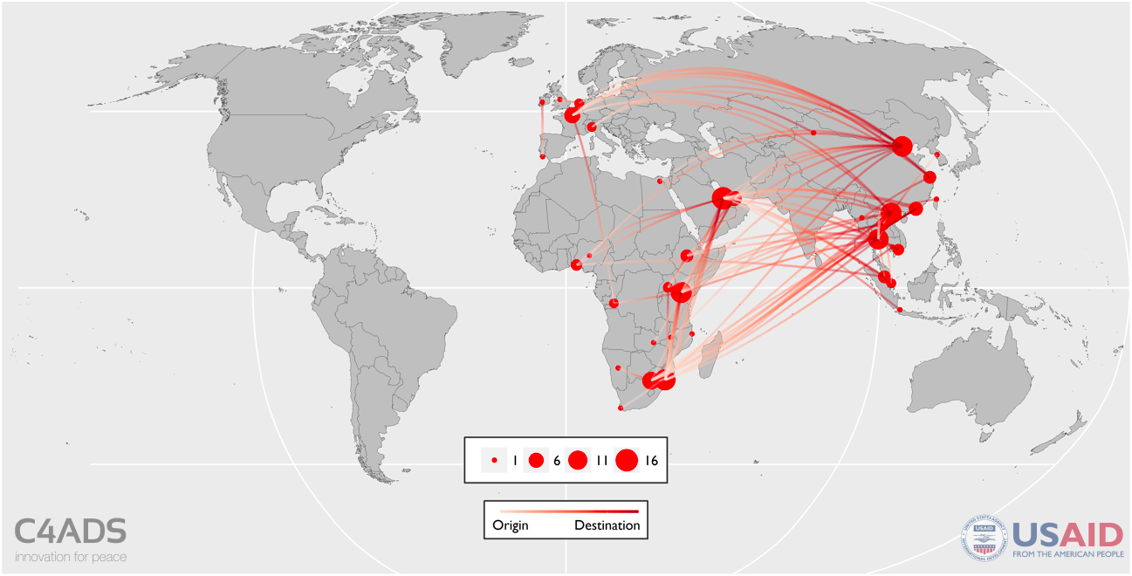
Rhino Horn Flight Routes
Ivory and rhino horn primarily moved between Africa and Asia, but often transited through hub airports in the Middle East and Europe as well.
Top 5 Countries by Trafficking Instance Count:
China
Mozambique
Vietnam
South Africa
Qatar
Rhino horn has a narrower supply chain than ivory, and concentrates in Southern Africa, China, and Vietnam
Rhino Horn Trafficking Routes Map (Jan 2009 – Aug 2016)
Unless specifically stated, the mention of any company, organization, individual, or other entity in this document or any attachments thereto does not imply the violation of any law, statue, or international agreement, and should not be construed as such. SBU Business Proprietary - Not for External Release
Notes:
The rhino horn map looks a lot like the ivory map, but rhino horn routes are far more concentrated, since rhino populations are significantly smaller than elephant populations. We can see a clear shift to Southern Africa (although Nairobi, Europe, and the Middle East are still used as transit regions), and the concentration of destinations in a few Asian airports (mostly in China and Vietnam).

Slide 8
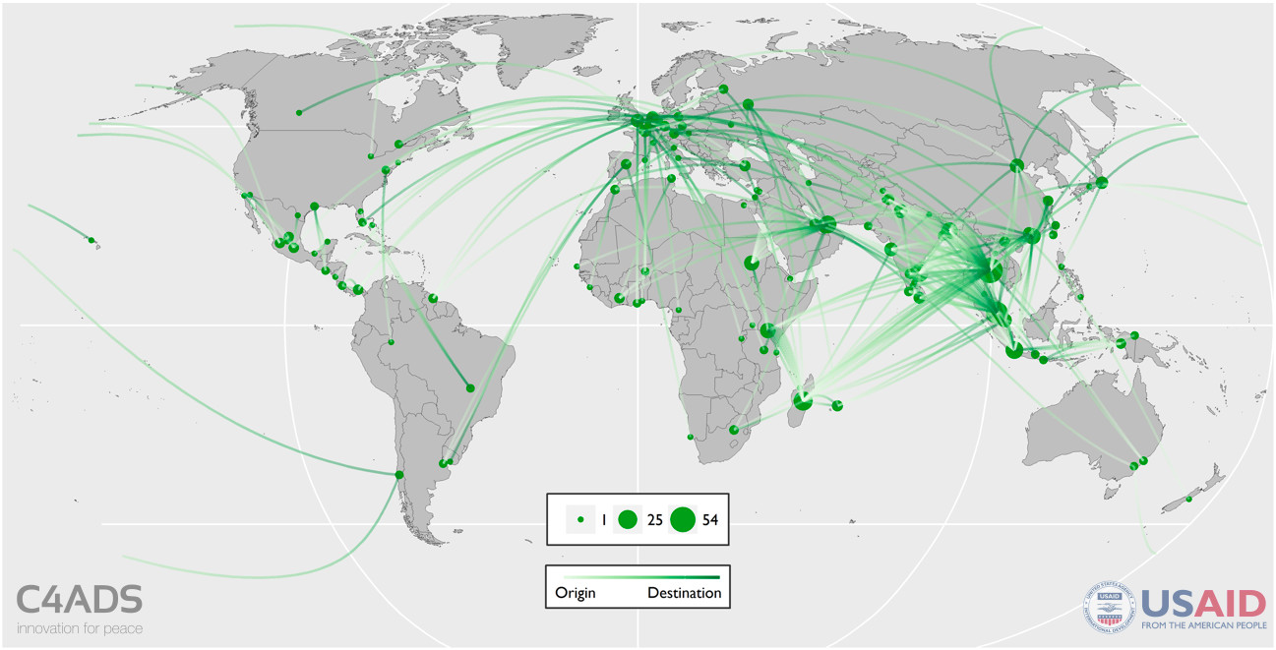
Reptile Flight Routes
Reptile trafficking routes were much more diverse, but seemed to concentrate in South and Southeast Asia, the Middle East, Europe, and North America.
Top 5 Countries by Trafficking Instance Count:
India
Thailand
China
Indonesia
Malaysia
South Asian reptile trafficking is primarily driven by the trade in black pond turtles (CITES Appendix I) and Indian star tortoises (CITES Appendix II)
Reptile Trafficking Routes Map (Jan 2009 – Aug 2016)
Unless specifically stated, the mention of any company, organization, individual, or other entity in this document or any attachments thereto does not imply the violation of any law, statue, or international agreement, and should not be construed as such. SBU Business Proprietary - Not for External Release
Notes:
The reptile map is clearly more geographically diverse than either ivory or rhino horn, which makes sense given that reptiles can be sourced from virtually all over the world. The biggest region for reptiles is South/SE Asia, where the reptile trade is primarily driven by the trade in black pond turtles and Indian star tortoises (both endangered). Other prominent regions include Europe (destination), Middle East (transit, destination), and Americas (origin, destination).

Slide 9
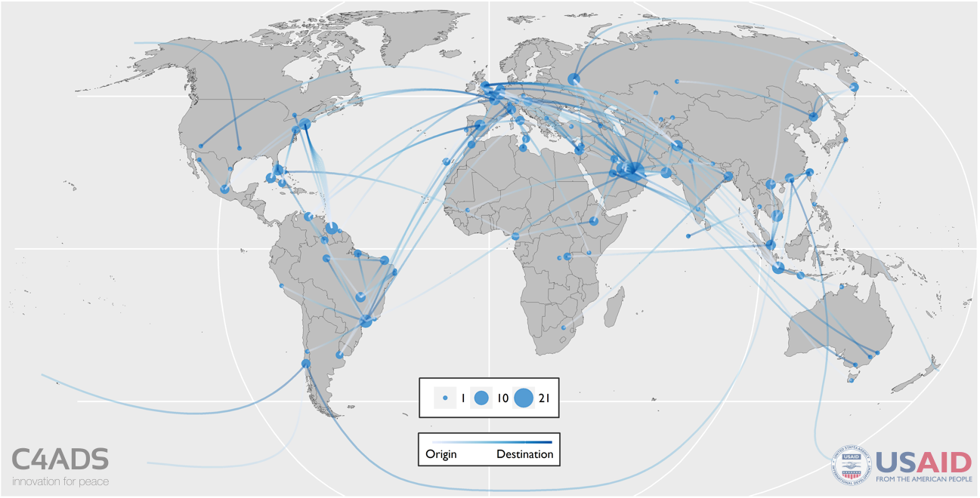
Bird Flight Routes
Bird trafficking routes were by far the most diverse of the four, but primarily affected the Middle East, Europe, the Americas, and Southeast Asia.
Top 5 Countries by Trafficking Instance Count:
UAE
Brazil
USA
Russia
Pakistan
The USDA has banned bird imports from 49 countries due to “highly pathogenic” avian influenza; 38% of bird seizures originated in one of these 49 countries
Bird Trafficking Routes Map (Jan 2009 – Aug 2016)
Unless specifically stated, the mention of any company, organization, individual, or other entity in this document or any attachments thereto does not imply the violation of any law, statue, or international agreement, and should not be construed as such. SBU Business Proprietary - Not for External Release
Notes:
By far the most diverse category. Like reptiles, birds can come from almost anywhere. Africa’s diminished role in the reptiles database almost entirely disappears in the birds database, and the Middle East, Europe, and the Americas become the biggest players. There are far more direct flights (Guyana -> NYC is particularly prominent) in this category as well, since birds are vulnerable to changes in temperature and pressure and are therefore hard to smuggle. We also see more domestic flights, particularly in Brazil and Russia, as birds are moved from more remote airports to airports in Sao Paulo, Moscow, etc. Finally, bird trafficking poses a health risk to the airline industry/enforcement/the public unlike the other categories; we found that 38% of bird seizures originated in one of 49 countries with “highly pathogenic” avian influenza according to the USDA.

Slide 10
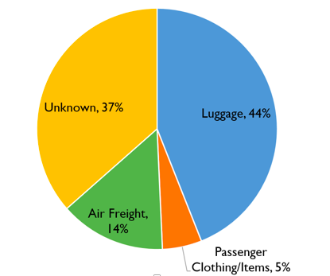
Modus Operandi
Most traffickers that exploit the air transport system use a combination of common trafficking modus operandi to evade detection in airports.
Obfuscation Methods
Tin or aluminum foil
Paper
Blankets
Agricultural products (beans, avocados, garlic, etc.)
Luggage
Abandoned or exchanged luggage
Use of multiple suitcases (e.g. eight suitcases for three people)
Documentation
Incorrect or incomplete customs documentation (i.e. fake addresses, defunct or shell companies)
Falsification of CITES e-permits
Unusual Flight Routes
Circuitous flight route (e.g. EBB-ADD-NBO-DXB-HCM-PEK)
Very quick turnaround after a long flight
Other
Custom-made clothing
Use of ketamine and other drugs to sedate live animals
Taxidermy
Transport Method Breakdown (Jan 2009 – Aug 2016)
Unless specifically stated, the mention of any company, organization, individual, or other entity in this document or any attachments thereto does not imply the violation of any law, statue, or international agreement, and should not be construed as such. SBU Business Proprietary - Not for External Release
Notes:
As part of our analysis, we compiled a list of common MOs we saw used by wildlife traffickers. First of all, we noticed that even though we frequently hear that wildlife trafficking in the aviation sector is a cargo issue, we found that wildlife was most often moved by luggage. Second, many of the common MOs we identified are frequently used by different types of traffickers.

Slide 11
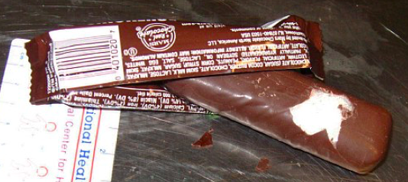
Modus Operandi
Most traffickers that exploit the air transport system use a combination of common trafficking modus operandi to evade detection in airports.
July 2013, Macau: 34 kg Ivory Hidden in Chocolate
July 2012, Los Angeles: Meth Hidden in Chocolate
Notes:
For example, in July 2013, 34 kg of ivory was found hidden in chocolate in Macau after an official noticed that the shipment’s weight was unusual for chocolate. Only one year earlier, meth had been found hidden in chocolate bars in LA – essentially the same MO.

Slide 12
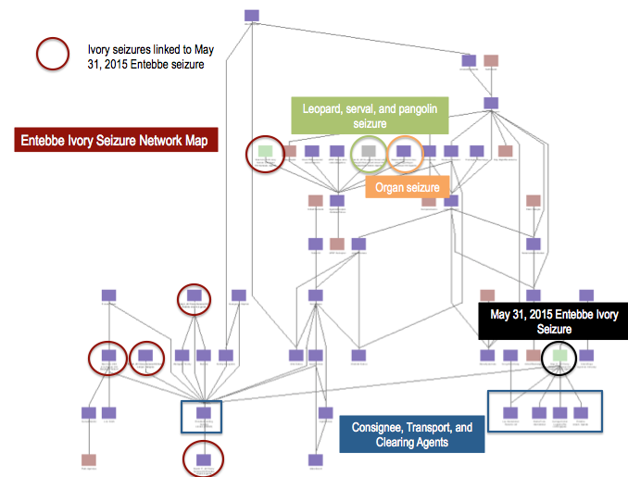
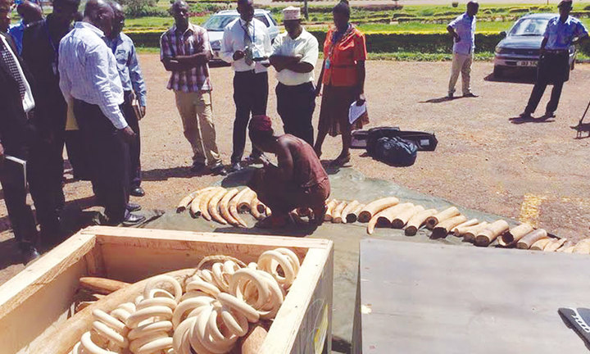
Sample Seizures
Multi-national networks exploit several loopholes in compliance, screening, and due diligence procedures in airports.
Common Compliance Failures & Risk Indicators
Consignor or consignee displays characteristics of a shell company (highly generic or incomplete name, recent incorporation date, low share capital, no recent or comparable trade activity)
Shipment paperwork falsified, improperly filled out, or missing fields
Consignment did not pass through hand search, visual checks, or trace detectors
Consignee directors in high-risk TBML industries
Seizure Date: May 31, 2015 (Entebbe, Uganda)
Contraband: 608kg ivory
Flights: TK 0569, TK 1979, TK 0054
Routes: EBB-IST-LHR; EBB-IST-SIN
Declared: “Aircraft Parts” and “Videography Equipment”
Method: Cargo
Weight written in pen on air cargo manifest as full 100 kg above declared weight
Ivory is removed from packaging on May 31, 2015 in Uganda
Unless specifically stated, the mention of any company, organization, individual, or other entity in this document or any attachments thereto does not imply the violation of any law, statue, or international agreement, and should not be construed as such. SBU Business Proprietary - Not for External Release
Notes:
During our analysis, we found a number of seizures that displayed one or more red flag indicator. In this case, 608 kg of ivory was found in May 2015 in Entebbe that showed multiple common signs of an illicit shipment. First, the flight route of the two shipments involved: Entebbe is a common origin/transit for ivory, and Istanbul is sometimes used as a transit point for ivory. LHR and SIN were probably additional transit points, and both airports are occasionally used for transiting illicit goods (both are well-connected airports, and passengers/luggage/cargo generally can’t be screened in transit). Both shipments were declared as “parts” or “equipment,” which is a common declaration for illicit shipments, alongside things like “plastic scrap” and “used tires.” But the paperwork for the shipment was perhaps most interesting. The consignor and consignee displayed characteristics of a shell company (generic names, no identifiable trade activity), and were seemingly engaged in high-risk TBML industries (used tires, used cars, etc.). The weight on the shipment paperwork was also incorrect, and someone had written the correct weight on the paperwork in pen as a full 100 kg above declared weight. We also found through our analysis that the network that moved this shipment had moved leopards, servals, pangolins, and organs in the past.

Slide 13
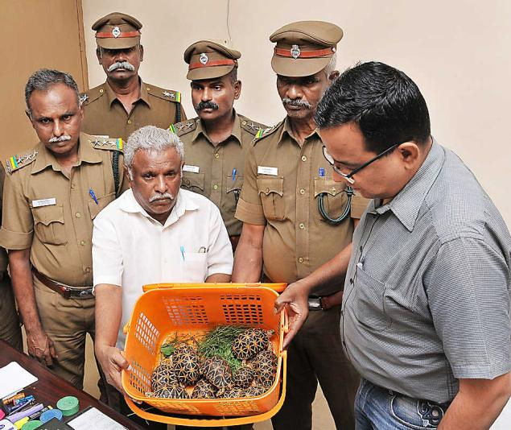
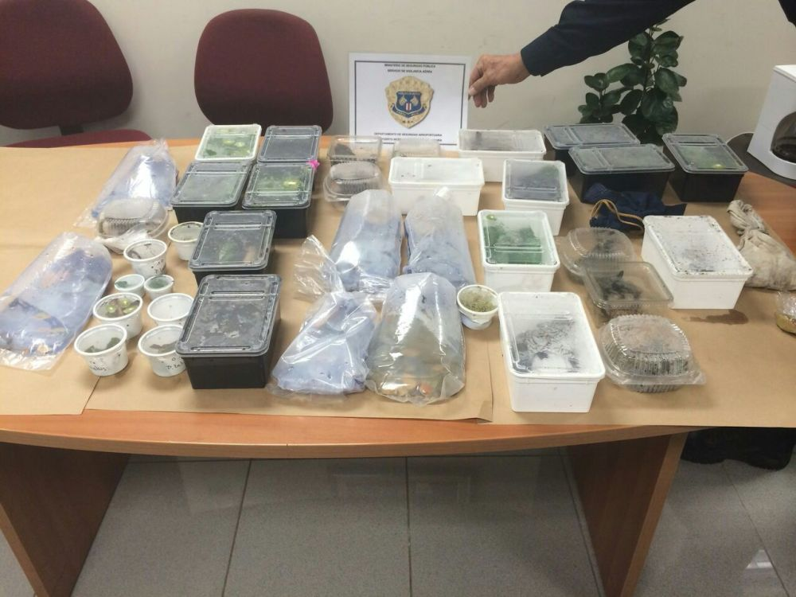
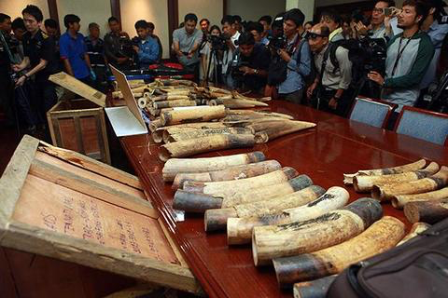
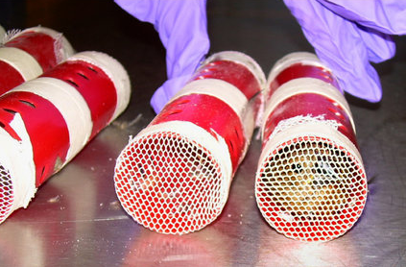
Sample Seizures
Seizure Date: Sep 27, 2015 (Tamil Nadu, India)
Contraband: 247 Indian star tortoises (Appendix II)
Flights: Unknown
Route: IXM – CMB - KLIA
Method: Luggage
Suspect had often worked as
a drug mule, moving drugs
including Ketamine (a sedative). Most
previous seizures at this airport had
been of either drugs or gold, and they
had never seized tortoises before.
Seizure Date: Sep 9, 2014 (San José, Costa Rica)
Contraband: 438 reptiles
Flights: unknown
Route: SJO - PTY - DUS
Method: Luggage
Suspect continues to run a reptile
business in Germany. He posts
photos on Facebook of dozens of
CITES permits at a time, and uses
Lufthansa Animal Lounge
Seizure Date: July 3, 2015 (Bangkok, Thailand)
Contraband: 250kg ivory
Flights: ET 831 and ET 618
Route: BZV-ADD-SIN-KUL-BKK-VTE
Declared: “Marble Pieces”
Method: Cargo
Hidden in wooden crates marked
marble pieces” containing four
suitcases of ivory
Seizure Date: 2012 (New York City, USA)
Contraband: 9 finches
Airline: Easy Jet
Route: GEO - JFK
Method: Passenger
Suspect was stopped by US CBP
with nine finches stuffed in
toilet paper rolls, covered with
netting and packaging tape, up his
sleeves. He had been caught
smuggling finches on the same
route 4 times previously.
Unless specifically stated, the mention of any company, organization, individual, or other entity in this document or any attachments thereto does not imply the violation of any law, statue, or international agreement, and should not be construed as such. SBU Business Proprietary - Not for External Release
Notes:
Each of these examples illustrates one or more red flags or interesting developments in wildlife trafficking. 1. The suspect was a drug mule, but had been asked to move turtles instead of ketamine (one of the drugs he usually moved, and frequently used to sedate trafficked animals). Madurai had been associated with drugs and gold until this point, and officials believed the traffickers thought the authorities in Madurai would not be looking for reptiles (this was their first reptile seizure). Madurai was also growing in size at the time, and adding on new routes, which traffickers often exploit. 2. The suspect in this case runs a reptile business, and sells hundreds of reptile (some protected species) and even one mammal online. He has advertised that he possesses dozens of CITES permits, even though he has been caught smuggling before. He often states that many of his clients are in the US, and posts photos of crates of animals in front of Lufthansa Animal Lounge. 3. Similar to the ivory seizures from before, so very quickly, this is another example of a circuitous transit route through hubs being used by a wildlife trafficker. “Marble pieces” is another common declaration for ivory. 4. Finches are very, very commonly flown between Guyana and NYC, always in very similar ways (either hair curlers or toilet paper rolls in their clothes or hand baggage). In this particular case, the suspect had been caught smuggling finches on the same route 4 times previously, and he is one of many doing the exact same thing. And yet they are able to continue to operate.

Slide 14
Wildlife Trafficking Legislation
The U.S. Congress has passed two federal laws that give the U.S. government fairly broad authority to address wildlife trafficking within the United States and abroad.
Convention on International Trade in Endangered Species of Wild Fauna and Flora (CITES) (1975)
CITES is a binding international agreement that provides a framework for member countries to monitor the international trade in certain species. Member countries can vote to place protected species and populations on one of three appendices:
Appendix I: Trade in specimens of Appendix I species is “permitted only in exceptional circumstances.”
Appendix II: Trade in specimens of Appendix II species is controlled to ensure their continued survival.
Appendix III: These species are “protected in at least one country, which has asked other CITES Parties for assistance in controlling the trade.”
Source: https://www.cites.org/eng/disc/how.php
Lacey Act (1900, amended 2008)
The Lacey Act is the first federal law protecting wildlife in the United States. Under the Act, it is “unlawful to import, export, sell, acquire, or purchase fish, wildlife or plants that are taken, possessed, transported, or sold:
in violation of U.S. or Indian law, or
in interstate or foreign commerce involving any fish, wildlife, or plants taken, possessed, or sold in violation of State or foreign law.”
The Lacy Act enforces civil and criminal penalties for the illegal trade of animals and plants protected under U.S. law or CITES.
Source: www.fws.gov/international/laws-treaties-agreements/us-conservation-laws/lacey-act.html
Eliminate, Neutralize, and Disrupt (END) Wildlife Trafficking Act (2016)
The END Wildlife Trafficking Act establishes coordination and collaboration requirements for the Presidential Task Force on Wildlife Trafficking, and allows the State Department and USAID to ”design and implement programs in focus countries for:
increasing the capacity of wildlife law enforcement and customs and border security officers in the countries; or
combatting the transnational trade in illegal wildlife.”
Source: www.congress.gov/bill/114th-congress/house-bill/2494
Unless specifically stated, the mention of any company, organization, individual, or other entity in this document or any attachments thereto does not imply the violation of any law, statue, or international agreement, and should not be construed as such. SBU Business Proprietary - Not for External Release
Notes:
What can we do about this issue? There are national laws and international legal frameworks in place that give enforcement authorities fairly broad powers to go after wildlife traffickers (although of course varies from country to country). CITES provides countries with a way to monitor the international trade in certain species. Traffickers operating in violation of CITES can be prosecuted in many countries, including the US, where the Lacy Act enforces civil and criminal penalties for the illegal trade of wildlife protected under US law or CITES. US also has the END Act, which allows the State Dep and USAID to develop programs to increase the capacity of wildlife LE/customs/etc. and to combat the transnational illegal wildlife trade in general.

Slide 15
Recommendations
Data-based recommendations to reduce wildlife trafficking in the air transport sector for industry and enforcement.
Awareness
Enforcement
Seizure Reporting
Increase awareness among air passengers, airline and airport employees.
Adopt or create information to assist in identification of wildlife trafficking.
Develop escalation procedures upon discovery of potential illegal activity.
Develop post-seizure procedures to secure and/or care for live wildlife and products.
Increase risk controls for flights to and from known trafficking hubs.
Develop or enhance security procedures for transit flights.
Develop and maintain a database of entities previously involved in wildlife seizures.
Develop a system to test wildlife seizure protocols.
Develop clear protocols for reporting suspected illegal wildlife to customs and enforcement officials.
Maintain a centralized database of relevant seizure information for risk management.
Training
Prevention
Train on red flag indicators associated with wildlife traffickers and shipments.
Create and provide training on safe handling of trafficked animals.
Incorporate training on wildlife protocols into existing programs.
Move towards electronic paperwork for air freight and updated technology for screening.
Further detail on each recommendation, as well as examples of past successful implementation of the recommendations and/or organizations to contact for assistance, are available in the report.
Unless specifically stated, the mention of any company, organization, individual, or other entity in this document or any attachments thereto does not imply the violation of any law, statue, or international agreement, and should not be construed as such. SBU Business Proprietary - Not for External Release
Notes:
Although these laws and legal frameworks exist, wildlife trafficking clearly remains a problem. In response, we developed recommendations based on what we found to still be lacking in the air transport sector. Our recommendations are designed for use by enforcement and by the private sector. In terms of enforcement, we primarily stressed that the proper procedures should be in place to deal with instances of potential illegal wildlife trafficking, and that seizures and seizure information should be properly documented and stored. Ideally, some of this information would be shared publicly to inform analyses like our own, and could be used to illustrate enforcement’s successes and attention to wildlife trafficking. Although it isn’t the private sector’s responsibility to enforce wildlife laws, the private sector can reduce exposure to wildlife trafficking and help to fix the problem by increasing awareness within the private sector, especially if procedures are in place for employees to appropriately react to and report suspected wildlife trafficking instances to the relevant authorities. Overall, want to stress that strengthening awareness of this issue and procedures to deal with these trafficking methods will have an impact on not only wildlife trafficking, but also on other crime types that are currently benefiting from the same loopholes. Our analysis clearly shows that this is a global issue that relies on criminal trafficking methods and low penalties to get by. To combat it effectively, the public sector, private sector, and government will need an international, collaborative approach.

Slide 16
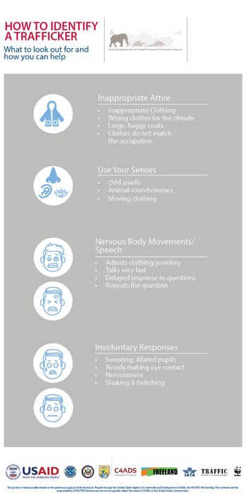
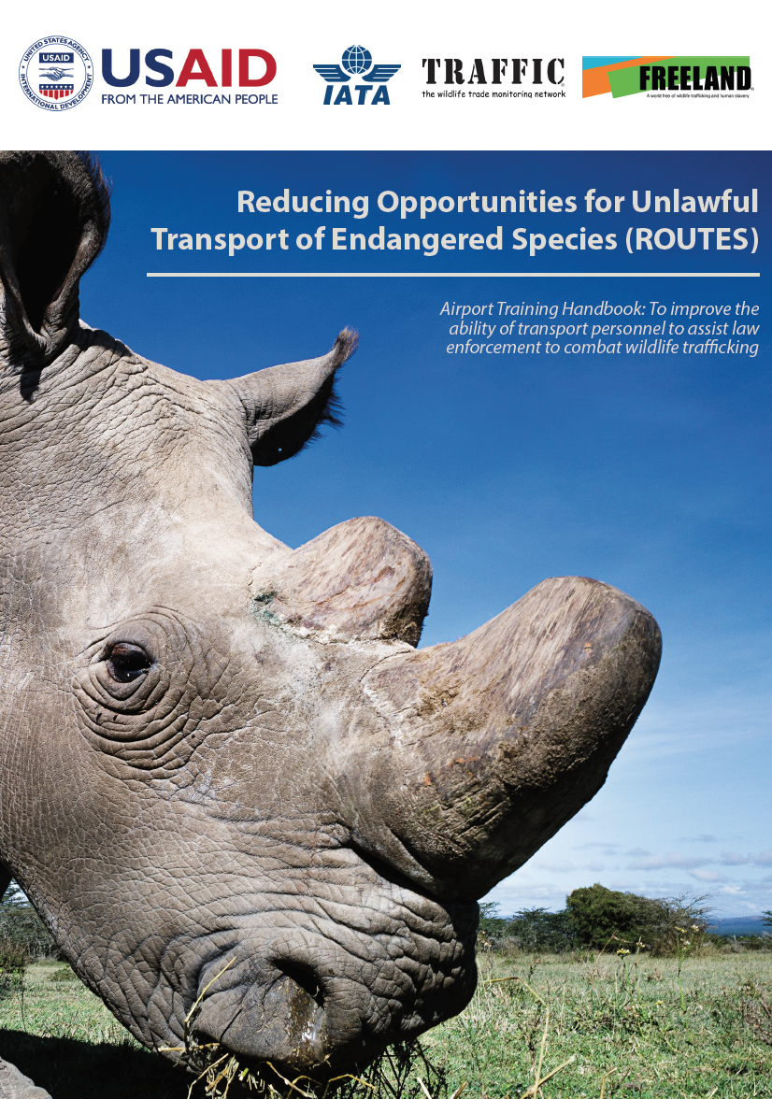
Implementing Recommendations
ROUTES is working with industry to reduce wildlife trafficking in the air transport sector
Awareness
Seizure Reporting
ROUTES is working directly with industry members and has created a suite of customizable resources to:
increase awareness among staff and personnel
assist in identification of common methods and signs of wildlife trafficking
ROUTES is supporting industry to:
develop protocols for reporting wildlife trafficking concerns
strengthen information exchange with enforcement agencies
Training
Prevention
ROUTES has and will develop :
Training modules on wildlife trafficking in air transport including red flag indicators
Information on safe handling of trafficked animals
Introduction and role specific training to be included into existing training programs.
ROUTES will work with industry to:
support implementation of electronic paperwork (e-permits)
Investigate opportunities for innovative and updated screening technology.
For more information visit www.routespartnership.org
Unless specifically stated, the mention of any company, organization, individual, or other entity in this document or any attachments thereto does not imply the violation of any law, statue, or international agreement, and should not be construed as such. SBU Business Proprietary - Not for External Release

Slide 17
Core Team
U.S. Agency for International Development
Center for Advanced Defense Studies
Freeland
International Air Transport Association
TRAFFIC
U.S. Department of Homeland Security
U.S. Department of State
U.S. Fish and Wildlife Service
WWF
Partners
Airlines for America
African Wildlife Foundation
Airports Council International
CITES Secretariat
Emirates Airlines
Delta Airlines
Global Environment Facility
INTERPOL
Kenya Airways
Michigan State University
Qatar Airways
SGS S.A.
United for Wildlife
United Airlines
United Nations Development Programme
United Nations Office on Drugs and Crime
U.S. Army Research Office
Wildlife Conservation Society
World Bank
This presentation is made possible by the generous support of the American people through the United States Agency for International Development (USAID). The contents are the responsibility of C4ADS and do not necessarily reflect the views of individual ROUTES Partners, USAID or the United States Government.
www.routespartnership.org

